Slide 1
Functional programming

Slide 2
Functional paradigm
Pure Functional Programming is simply about
avoiding side-effects.
https://www.aomran.com/pure-functional-programming/

Slide 3
Side-effect 1
When a program modifies state:
let count = 0 // starting state const incrementor = () => { count + 1;
};
Notes:
Above is a function that causes a “side-effect” by changing the count variable outside of its scope.

Slide 4
Side-effect 2
When a program mutates data:
const array = [1,6,4,2];
const sorter = () => {
array.sort();
};
Notes:
The sort method mutates the array, so our [1,6,4,2] state is gone forever.
A mutation is a side effect. The fewer things that change in a program, the less there is to keep track of, and the result is a simpler program.

Slide 5
Side-effect 3
When a program interacts with I/O
const myLogger = (output) => { console.log("Log:", output);
};
Notes:
A program that raises an error, writes data to disk, or prints something on the screen is causing a “side-effect.”

Slide 6
Problems with Side-effects
Functions are hard to test
Functions have no fixed behavior
Functions cannot be reused
Notes:
A program that raises an error, writes data to disk, or prints something on the screen is causing a “side-effect.”
When a function produces a side effect you have to know more than just its inputs and output to understand what that function does

Slide 7
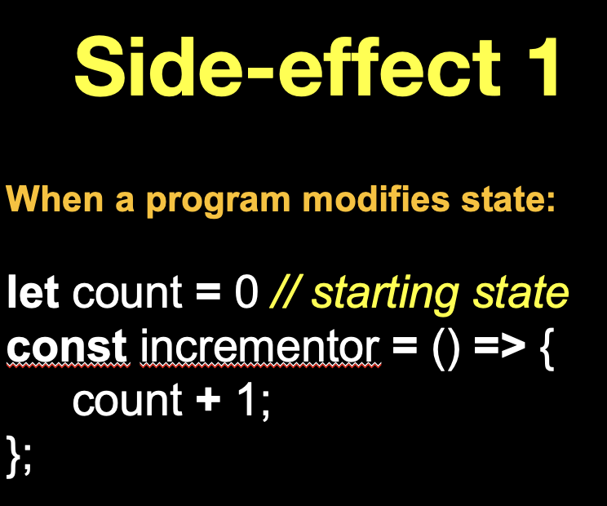
Avoiding Side-effects 1
Pure functions depend only on their input-arguments and return a value without causing side-effects.
const incrementor = (count) => {
count + 1;
};
Notes:
Pure functions depend only on their arguments and return a value without causing side-effects. These functions will always return the same output given a specific input. JE KAN NU DE FUNCTIE AANROEPEN VOOR DE JUISTE WAARDE ipv DE GLOBALE ‘COUNT’ VAR.

Slide 8
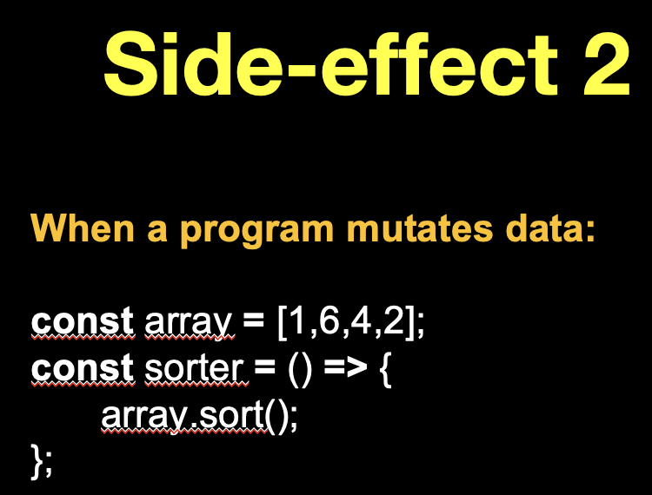
Avoiding Side-effects 2
Inputs should be immutable !
const array = Object.freeze([3,1,2]);
const getFirst = (array) => {
return array[0];
};
getFirst(array) // 3
array.sort(); // TypeError
getFirst(array) // 3 ) // 3
Notes:
Pure functions depend only on their arguments and return a value without causing side-effects. These functions will always return the same output given a specific input.

Slide 9
Avoiding Side-effects 2
Inputs should be immutable !
const prevArr = Object.freeze([3,1,2]); // immutable
const array = [ ...prevArr ] // copy with spread operator
const getFirst = (array) => {
return array[0];
};
getFirst(array) // 3
array.sort();
getFirst(array); // 1) // 3
Notes:
We can’t change immutable data types, so we have to make a copy.

Slide 10
Array https://developer.mozilla.org/en-US/docs/Web/JavaScript/Reference/Global_Objects/Array/prototype#Mutator_methods
mutator array methods
push()
sort()
non-mutator array methods (immutable)
map()
filter()
reduce()

Slide 11
Array
const numbers = [1, 2, 3, 4];

Slide 12
For-loop
let numbers = [1, 2, 3, 4];
let newNumbers = [ ];
for(let i = 0; i < numbers.length; i++) {
newNumbers[i] = numbers[i] * 2;
}
console.log("The doubled numbers are", newNumbers); // [2, 4, 6, 8]

Slide 13
For-loop use Array.map()
let numbers = [1, 2, 3, 4];
let newNumbers = numbers.map( (number) => { return number * 2;
});
console.log("The doubled numbers are", newNumbers); // [2, 4, 6, 8]
Notes:
Think of map as a "for each" loop, that is specifically for transforming values - one input value corresponds to one 'transformed' output value.

Slide 14
Chaining functions
let numbers = [1, 2, 3, 4];
let newNumbers = numbers.map( (number) => { return number * 2;
}).map( (number) => {
return number + 1;
});
console.log("The numbers are", newNumbers); // [3,5,7,9]

Slide 15
Rules map-method
The amount of input elements is equal to the amount of output elements
Your callbacks shouldn't 'mutate' values
Don't cause side-effects!
Notes:
If the 'source array' has an X amount of elements, then the resulting aray will also have X elements.
What this means, is really just that you shouldn't modify objects or arrays directly from within your callbacks - if the input value is an object or an array, clone it instead, and modify the copy.
You should never do anything in a map call that modifies 'state' elsewhere.

Slide 16
Transform values
let numbers = [1, 2, 3, 4];
let newNumbers = [ ];
for(let i = 0; i < numbers.length; i++) {
if(numbers[i] % 2 !== 0) {
newNumbers[i] = numbers[i] * 2;
}
}
console.log("The doubled numbers are", newNumbers); // [2, 6]
Notes:
Welk getal is NIET deelbaar door 2. (1 en 3)

Slide 17
Transform values use Array.Filter()
let numbers = [1, 2, 3, 4];
let newNumbers = numbers.filter((number) => { return (number % 2 !== 0);
}).map( (number) => {
return number * 2;
});
console.log("The doubled numbers are", newNumbers); // [2, 6]

Slide 18
Combine values
let numbers = [1, 2, 3, 4];
let totalNumber = 0;
for(let i = 0; i < numbers.length; i++) {
totalNumber += numbers[i] * 2;
}
console.log("The total number is", totalNumber); // 20

Slide 19
Combine values use reduce-method
let numbers = [1, 2, 3, 4];
let totalNumber = numbers.map( (number) => { return number * 2;
}).reduce( (total, number) => {
return total + number;
}, 0);
console.log("The total number is", totalNumber); // 20

Slide 20
Higher order functions
Takes one or more functions as input-arguments
and / or
Returns a function as its result

Slide 21
Higher order functions
// The function addThenSquare is made by combining the functions add and square.
const add = function ( x, y ) {
return x + y;
};
const square = function ( x ) {
return x * x;
};
const addThenSquare = function ( x, y ) {
return square(add( x, y ));
};
const result = addThenSquare ( 1, 2);

Slide 22
Currying
Currying is the process of translating a function that takes multiple arguments into a series of functions that each take one argument.
https://www.sitepoint.com/currying-in-functional-javascript/
Notes:
Currying may be useful if you have a function that you are passing around as a first class object, and you don't receive all of the parameters needed to evaluate it in one place in the code. You can simply apply one or more parameters when you get them and pass the result to another piece of code that has more parameters and finish evaluating it there.

Slide 23
Currying
function sum3(x, y, z) { return x + y + z; }
console.log(sum3(1, 2, 3) // 6
Currying
function sum3(x) { return (y) => { return (z) => { return x + y + z; }; }; }
console.log(sum3(1)(2)(3)) // 6
Notes:
The curried version of sum3 behaves a little differently. For starters, it accepts only one argument and returns a function. The returned function also accepts one argument and also returns a function.

Slide 24
Currying
const multiply = function ( x, y ) {
return x * y;
};
const curry = function ( fn ) {
return function ( x ) {
return function ( y ) {
return fn( x, y );
};
};
};
const curriedMultiply = curry( multiply );
const double = curriedMultiply( 2 );
const triple = curriedMultiply( 3 );
const quadruple = curriedMultiply( 4 );
console.log(triple( 6 )); // 18
Notes:
Currying may be useful if you have a function that you are passing around as a first class object, and you don't receive all of the parameters needed to evaluate it in one place in the code. You can simply apply one or more parameters when you get them and pass the result to another piece of code that has more parameters and finish evaluating it there.

Slide 25
Recursion
const factorial = function ( n ) {
if ( n === 0 ) {
return 1;
}
return n * factorial( n - 1 );
};
console.log(factorial( 10 )); // 3628800

Slide 26
Exercise Array.Reduce()
const array1 = [1, 2, 3, 4];
const reducer = (accumulator, currentValue) => accumulator + currentValue;
Questions:
add all values in the array and print the total. Only use: Array.reduce ()
2. add all values in the array + add an initial value and print the total. Only use: Array.reduce ()
Hint:
Use editor in MDN: https://developer.mozilla.org/en-US/docs/Web/JavaScript/Reference
Notes:
https://developer.mozilla.org/en-US/docs/Web/JavaScript/Reference

Slide 27
Exercise Array.map()
var array1 = [1, 4, 9, 16];
Question:
Pass a function to map, so that the expected output is: Array [2, 8, 18, 32]
const map1 = array1.map( ? );
console.log(map1);
Hint:
Use editor in MDN !

Slide 28
Exercise Array.filter()
let words = ['spray', 'limit', 'elite', 'exuberant', 'destruction', 'present'];
const result = words.filter(word => {
?
});
Question:
Filter all words which are longer than 6
Hint:
Use editor in MDN !

Slide 29
Higher order functions
const result = addDivideThenSquareMultiply ( 2, 8);
Question:
Make a higher order function for addDivideThenSquareMultiply.
What is the result?

Slide 30
Currying
Question:
Make a curried version of this function:
var greet = function(greeting, name) {
console.log(greeting + ", " + name);
};
greet("Hello", "Heidi"); //"Hello, Heidi”
Solution:
https://www.sitepoint.com/currying-in-functional-javascript/
Notes:
See: https://www.sitepoint.com/currying-in-functional-javascript/

